Slide 1

Project Title: Firefighting Robot Area: IOT, Robotics and Machine Learning
Dr. D. Y. Patil Institute of Technology, Pimpri, Pune-18
Department of Electronics and Telecommunication Engineering
Mini Project Review 1 Presentation
Group members
TETC26 Shruti Awate TETC59 Yash Anap TETC69 Yash Chandane
Project Guide
Mithra Vyankateshan

Slide 2
Problem Statement
Fire-fighting task is one of the extreme and dangerous tasks to be carried out by human beings generally or specifically the firefighters.
In our Project robot normally travels at a constant pace. When the flame sensor detects a fire in the area, it sends a signal to the Arduino, which controls the fire suppression.
Whenever the robot senses a fire, it will stop near it and activate the pump, which will spray water through a sprinkler until the fire has dissipated.
Using Arduino and an infrared sensor, the robot is controlled automatically.

Slide 3
Objectives
The objective of this mini project is to design and build a robotic system capable of autonomously detecting and extinguishing fires in indoor environments. The robot should be able to operate in various scenarios, including residential buildings, offices, and industrial facilities.
Design and development of low-cost firefighting robot.
Run automatically firefighting robot.
Extinguish fire.

Slide 4
Literature Survey
1. Title: "Autonomous Firefighting Robot for Indoor Environments" Authors: Smith, J., Johnson, A., & Brown, L. Published in: International Journal of Robotics Research, 2018
This research paper presents the design and development of an autonomous fire-fighting robot specifically designed for indoor environments. The authors discuss the robot's hardware and software architecture, including its fire detection sensors, navigation system, and fire suppression mechanism. They provide experimental results demonstrating the robot's effectiveness in extinguishing fires in controlled scenarios.
2. Title: "A Review on Fire Fighting Robots" Authors: Sorniotti, A., Sorniotti, A., & Schilling, A. Published in: Procedia Engineering, 2017
This review paper presents a comprehensive overview of fire-fighting robots. It discusses the different types of robots used for fire suppression, including aerial robots, ground-based robots, and hybrid systems. The authors explore various fire detection methods, such as thermal imaging, gas sensors, and visual detection. The review also covers navigation techniques, communication systems, and future research directions in the field.

Slide 5
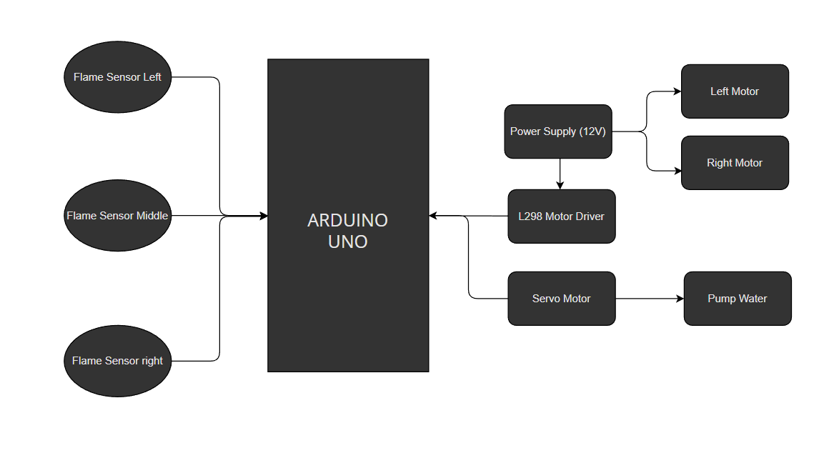
Block Diagram
Fig. Block Diagram for fire-fighting robot system

Slide 6
Methodology/Explanation
Problem Understanding: Clearly define the problem statement and objectives of the fire-fighting robot mini project. Understand the challenges associated with indoor fire extinguishing operations, such as limited access, intense heat, and toxic smoke. Identify the key requirements for the robot, including fire detection, navigation, fire suppression, communication, and safety features.
Literature Review: Conduct a thorough literature survey to gain insights into existing fire-fighting robots, their design principles, and the technologies used. Study research papers, articles, and technical documents related to fire detection methods, navigation algorithms, fire suppression mechanisms, and human-robot interaction in firefighting scenarios. Extract relevant information that can inform the design and development of the fire-fighting robot.
System Design: Based on the problem understanding and literature review, develop a system design for the fire-fighting robot. Determine the hardware components required, including sensors for fire detection (e.g., smoke detectors, temperature sensors, flame sensors), actuators for movement, and fire suppression mechanisms (e.g., water sprayers, foam dispensers). Consider power supply requirements, communication systems, and safety features.

Slide 7
Software Development: Design and implement the software architecture of the fire-fighting robot. Develop algorithms for fire detection, which can combine inputs from multiple sensors to accurately identify the presence and location of a fire. Create navigation algorithms that allow the robot to autonomously move through indoor spaces, avoiding obstacles and planning efficient paths to reach the fire. Implement control algorithms for the actuators, enabling the robot to carry out fire suppression activities effectively.
Hardware Integration: Integrate the hardware components with the software system. Connect the sensors, actuators, and communication modules to the microcontroller or control system. Ensure proper calibration and synchronization of the components. Test and debug the hardware integration to ensure seamless communication and functionality.
Testing and Evaluation: Conduct comprehensive testing of the fire-fighting robot. Create simulated fire scenarios in controlled environments to assess the robot's performance. Evaluate its ability to detect fires accurately, navigate through obstacles, and effectively extinguish fires using the fire suppression mechanism. Measure parameters such as speed, accuracy, and safety. Iterate and refine the design based on the test results.

Slide 8
Testing and Evaluation: Conduct comprehensive testing of the fire-fighting robot. Create simulated fire scenarios in controlled environments to assess the robot's performance. Evaluate its ability to detect fires accurately, navigate through obstacles, and effectively extinguish fires using the fire suppression mechanism. Measure parameters such as speed, accuracy, and safety. Iterate and refine the design based on the test results.
Documentation: Document the entire process of the fire-fighting robot mini project. Prepare a detailed report describing the problem statement, system design, hardware and software implementation, testing procedures, and results. Include diagrams, algorithms, code snippets, and experimental data to provide a comprehensive overview. Present the findings, limitations, and future scope of the project.
Presentation: Prepare a concise presentation summarizing the key aspects of the fire-fighting robot mini project. Highlight the challenges addressed, the innovation in design, and the performance of the robot. Present the project objectives, methodologies, and results to effectively communicate the work accomplished.

Slide 9
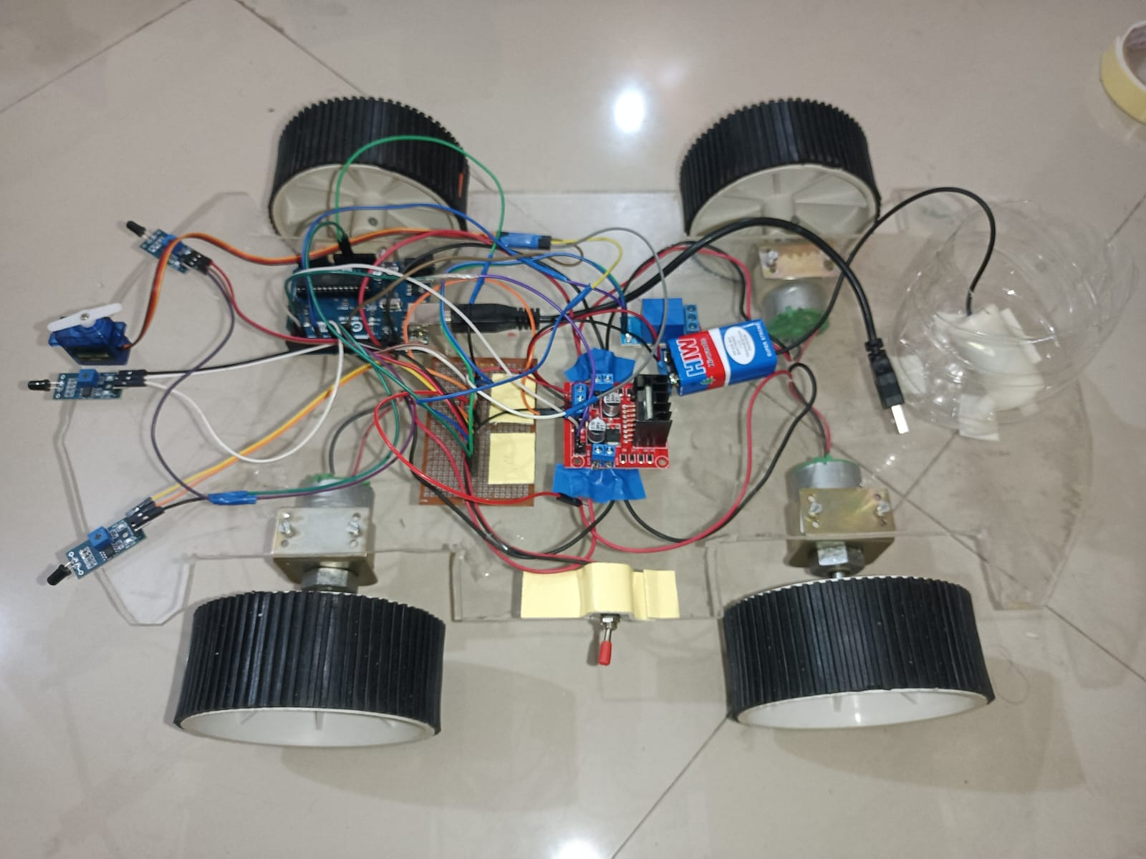
Software and Hardware Specifications
Software used:
Arduino IDE
Proteus
Hardware used:
Arduino UNO
Flame IR Sensor
Servo motor
L298 motor driven module
Robot Chassis
12v Battery
Connecting Wires
Nozzle for water
Water pump 5v
Single channel relay

Slide 10
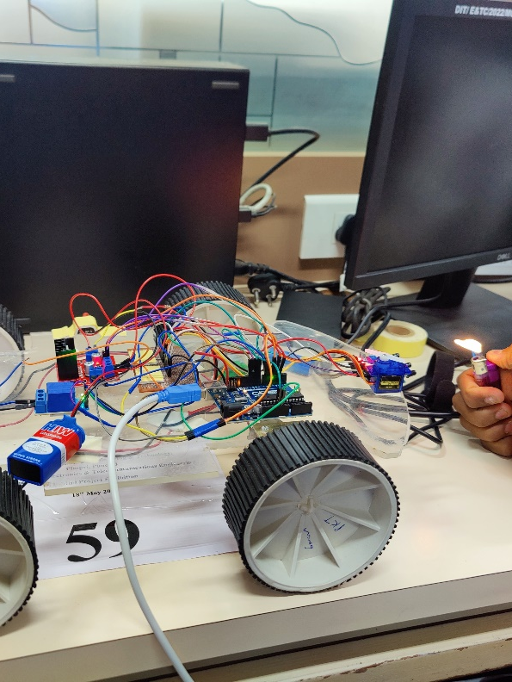
Expected Outcome
The expected outcome of the fire-fighting robot mini project is the successful design, development, and testing of an autonomous robot capable of detecting and extinguishing fires in indoor environments. The project aims to achieve the following outcomes:
Functional Fire-Fighting Robot
Reliable Fire Detection
Autonomous Navigation
Effective Fire Suppression
Remote Control and Communication
Documentation and Reporting

Slide 11
Application
The application of the fire-fighting robot mini project can have several practical uses and benefits in the field of firefighting. Some potential applications include:
Indoor Fire Suppression: The fire-fighting robot can be deployed in indoor environments such as residential buildings, offices, warehouses, or industrial facilities to suppress fires effectively.
Remote or Hazardous Areas: The robot can be utilized in situations where human firefighters face significant risks, such as in remote or hazardous areas.
Post-Fire Assessment and Cleanup: Once a fire is extinguished, the fire-fighting robot can be employed for post-fire assessment and cleanup.
Education and Training: The fire-fighting robot mini project can also be utilized for educational and training purposes
Assistance to Firefighters: The fire-fighting robot can serve as a valuable tool for human firefighters, providing support and assistance during firefighting operations.

Slide 12
THANK YOU

